Slide 1
Agency Prepayment: Turnover
April 2016

Slide 2
Model Update Overview 1. Data Set
1
Base Turnover – at least 30 bps OTM
In order to get turnover from total prepayments, we need to subtract Refinances, Defaults and Curtailments.
To estimate base turnover, we look at speeds on pools that are at least 30 bps OTM and that consequently should have zero refinancing rates. We then subtract defaults and curtailments to build our base turnover.
However, the OTM data includes some OTM Cashout refinances. We also need to subtract this contribution from our base turnover.
2
Pool Level Data Set
Consistent with the Curtailment and Default submodels, we use pool level information to fit and track the Turnover submodel.
3
Refinance Incentive
Incentive acts as a Lock-in factor in the Turnover model. In order to get a more accurate lock-in measurement, we made the following improvements for the pool level incentive calculation:
Modified origination PMI for HARPed loans (CQ/CR/MHA)
Used a loan-level estimate for the average incentive experienced by all loans in a pool instead of relying on the pool WAC.

Slide 3
Model Update Overview 2. Model Structure for v1
Turnover model V1
30-80 bp OTM
Data set
Base Turnover
2
Step Fitting
Using two data sets for different incentive ranges
Fit curves:
WALA
HPA2Yr
5
Parameters
At least 30 bp OTM
Data set
Seasonal Adj.
Seasonal Adjustment
WALA
HPA2Yr
Lock-In
CLTV
Fit curves:
Lock-in
CLTV
1
Adjustment Function
Tweaks for HPA2Yr

Slide 4
Model Update Overview 3. Model v1 versus v2
Turnover model V1
Updates for v2
2
1. Subtract OTM Cashout Refinances
Step Fitting
The OTM prepayment data includes some OTM cashout refinances. We need to remove that from our base turnover value.
Using two data sets for different incentive ranges
2. Add 1 Additional Parameter
Add Loan Purpose as an explanatory variable. The lock-in incentive is now performed at the loan level.
5
Parameters
3. Remove 2-step fitting process
Seasonal Adjustment
WALA
HPA2Yr
Lock-In
CLTV
Use all the pool level data that is at least 30 bps OTM to do the fitting process in one step.
4. Remove adjustment functions
The old model involved tweaks because we used loan level data to calibrate the model and then used these adjustment factors to fit pool level data
1
5. Add constraints for extrapolation
Adjustment Functions
Use cap and floors for out of range extrapolation. Make sure the tail performance is reasonable.
Tweaks for HPA2Yr

Slide 5
Data Preparation 1. Incentive – PMI calculations for HARPed loans
Q
uestion
Our previous calculation for HARPed loan incentive was misleading since HARPed loans typically pay no MI or carry over their MI from the previous loan.
So, what MI was the HARPed borrower paying before they refinanced?
P
roblem
We don’t have information about the borrower’s previous loan. Consequently, there is no straightforward way to determine the PMI at origination.
S
olution
Using our Enhanced HARPed Identification algorithm, we can identify a HARP% for each loan.
We use the MI coverage level to look up MI rates from before 2009/06 (using MGIC data) for all HARPed loans.

Slide 6
Data Preparation 2. Incentive – Improving Identification of HARPed Loans
Y: HARPed
HARP% = 100
Refi Loans
Orig. before 2014
Have Credit Data
Credit Data Mapping
Using Algo II
N: Non-HARPed
HARP% = 0
Refi Loans
Y: HARPed
HARP% = 100
LTV > 80%
MI Test
Using Algo I
HARP % for each loan
Recently Originated Refi Loans
N: Non-HARPed
HARP% = 0
LTV <= 80%
Logistic Regression Model*
Likelihood that loan has been HARPed
Using the Enhanced Algorithm
Pre-HARP
HARPed
Non-HARPed
Non-Eligible: Purchas, refi-CO
Based on an enhanced identification algorithm for HARPed loans, we are able to calculate pool PMIs more accurately (at the loan level) which in turn improves the accuracy of the incentive calculation.

Slide 7
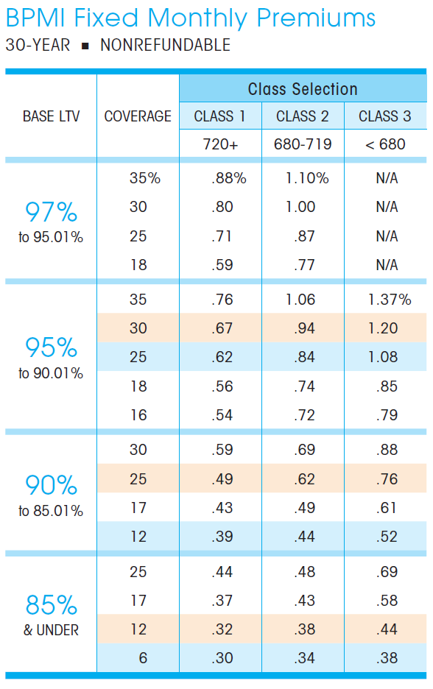

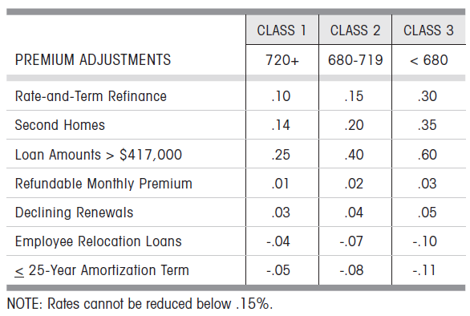
Data Preparation 3. Incentive - Previous MI Calculation
Example Loan:
Loan Seq Num: U60490000208
Find the MI premium based on loan info
firstPaymtDt | 4/1/2011
cs | 781
origLTV | 121
loanPurposeType | RE-FI-NCO
occType | OWNER
originalLoanAmount | 89,320
pctMtgIns | 20
As the LTV is greater than the largest number in the table, we assigned the maximum number (or a number of 1000 bps) in the table to the base MI (i.e., we ignore what the credit score is).
We will have a PMI of 110 bps for the loan.

Slide 8
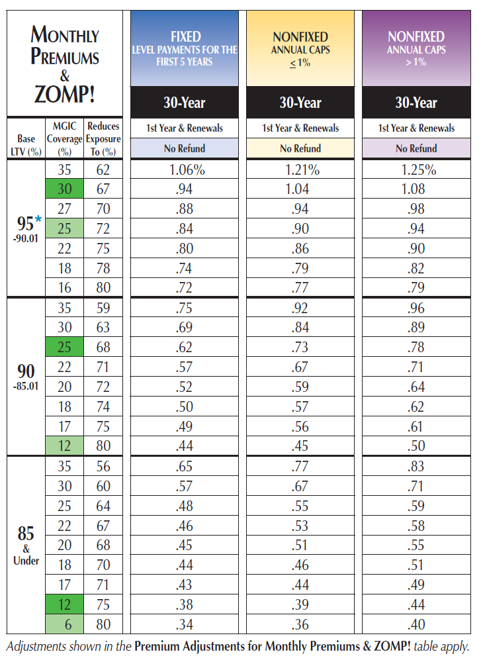

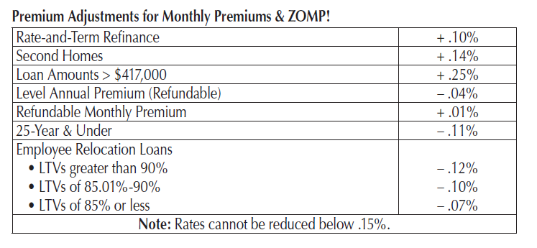
Data Preparation 4. Incentive - Updated MI Calculation
Example Loan:
Loan Seq Num: U60490000208
Look up the MI coverage
firstPaymtDt | 4/1/2011
cs | 781
origLTV | 121
loanPurposeType | RE-FI-NCO
occType | OWNER
originalLoanAmount | 89,320
pctMtgIns | 20
Based on the historical MI documents, we assign 79 bps MI to the example loan instead of 110 bps.
Makes the incentive 31 bps lower.

Slide 9
Data Preparation 5. Incentive – Loan level Aggregation
Q
uestion
Our current calculation for pool level incentive treats the pool as a single loan and uses the weighted average of the pool’s various characteristics (FICO, CLTV etc) to infer PMI and LLPA levels.
How accurate is the calculation?
P
roblem
Pool-level calculations mask dispersion.
The LLPA and PMI mappings are step functions, not linear functions. So, pool-level calculations that are near step thresholds can have significant biases.
S
olution
Use loan level incentive calculations, including LLPA and PMI.
Refine calculation of loan PMI for HARPed loans
Aggregate the loan level incentives to estimate pool incentive.

Slide 10
Data Preparation 6. Incentive – The Impact of Dispersion
The Impact of Loan Dispersion for calculating various pool characteristics
These is little difference between the pool- and loan-level calculations for FICO and CLTV. For LLPA and PMI calculations, the differences can be substantial because of the step-function effect.

Slide 11
Data Preparation 7. Incentive – Loan-level vs Pool-level for Different Tickers
Loan- vs Pool-level aggregations for Incentive (inclusive of fixing the Origination PMI for HARPed Loans):

Slide 12
Data Preparation 8. Incentive – Combining Pool- and Loan-Level Data
Combined Version for Conventional Pools
To handle the problem that there is no loan level data before 2006, we use pool level data before 2006.
The combined version is relatively reliable because the impact of LLPA/PMI is minor prior to 2006.

Slide 13
Data Preparation 9. OTM Cashout Refis
Q
uestion
30bps OTM prepayments can include cashout refinancings. In addition to defaults and curtailments, we also need to remove this contribution in order to isolate turnover-related prepayments.
P
roblem
There is no obvious way to estimate OTM cashout refinancing rates from MBS prepayment data.
S
olution
Based on an analysis that compares Turnover rates implied by Existing Home Sales to OTM MBS prepayment rates, it appears that OTM cashout refis can contribute between 2-4% CPR.
We specify a very simple model to capture the variation in these refi rates.

Slide 14
Data Preparation 10. OTM Cashout Refis – EHS Turnover vs MBS OTM Prepays
Turnover EHS
Existing Home Sales / Owner-occupied housing Stock
Turnover across all home owners, with or without mortgages (also, mortgage may be of any type)
Turnover MBS
Prepayments on all pools at least 30 bps OTM after subtracting defaults and curtailments
Potential OTM Cashout Refis
There is roughly a 4% difference between those two curves on average
When the difference of two curves gets smaller, we potentially have an OTM Cashout refinance wave.

Slide 15
Data Preparation 11. OTM Cashout Refis – Freddie Mac Cashout Data
Ratio of New mortgage rate to Old rate
Ratio of New to Old rate refers to the ratio of the interest rate of the new loan to the interest rate of the refinanced loan. Refinanced loans with adjustable-rate products are excluded.
When the Ratio of New to Old rate goes above 1, the interest rate of the refinanced loan is higher than that of the old loan. This likely corresponds to a significant amount of OTM Cashout Refis.
Potential OTM Cash-out Refi in EHS Analysis
Compare with the EHS Turnover analysis we can see that the potential OTM cash out refi period in the EHS analysis significantly overlaps the period when the ratio of the new to old rate >= 1.

Slide 16
Data Preparation 12. OTM Cashout Refis – Freddie Mac Cashout Data contd
5% Higher Loan Amount
"Higher Loan Amount" refers to loan amounts that were at least 5 percent greater than the amortized unpaid principal balance (UPB) of the original loan.
When the percent of borrowers with 5% Higher Loan Amounts goes up, there are more cash-out refinances.
Potential OTM Cash-out Refi in EHS Analysis
Comparing with the EHS Turnover analysis we can see the potential OTM Cashout refi period in the EHS analysis significantly overlaps the period when the fraction of borrowers with 5% Higher Loan Amount goes up.

Slide 17
Data Preparation 13. OTM Cashout Refis – Model Specification
Model to Estimate OTM Cashout Refis
We introduced a four-factor model to estimate OTM Cashout Refis
OTM Cashout Refi = Incentive * HPA2yr * CLTV *WALA
Cashout refis are capped at 4% CPR.

Slide 18
Data Preparation 14. OTM Cashout Refi – Model Output
Model to Estimate OTM Cash-out Refi
We introduced a four-factor model to estimate OTM Cash-out Refi
OTM Cashout Refi = Incentive * HPA2yr * CLTV * WALA
Cashout refis are capped at 4% CPR

Slide 19
v2 Turnover Model Details 1. Model Multipliers
01
Turnover shows clear seasonality. Removing the difference using seasonal adjustments helps in finding the spline functions for the model.
v2 of the turnover model includes the five prediction parameters listed on the left-hand side.
Sequentially fitting model with the five parameters, we can create a cubic spline curve for each one of these inputs.
The parameter ordering is based on a single parameter regression that calculates R-square values.
Parameters that appear earlier in the order will have a more significant impact on our model output.
Seasonal Adj.
02
The WALA ramp effect has turnover increasing as loan age goes up.
WALA
03
In environments with greater house price appreciation, borrowers will have a higher chance of selling their houses.
HPA2Yr
04
High levels of disincentive make it more costly for homeowners to move.
Lock-in
05
Borrower with higher CLTVs have more difficulty moving.
CLTV

Slide 20
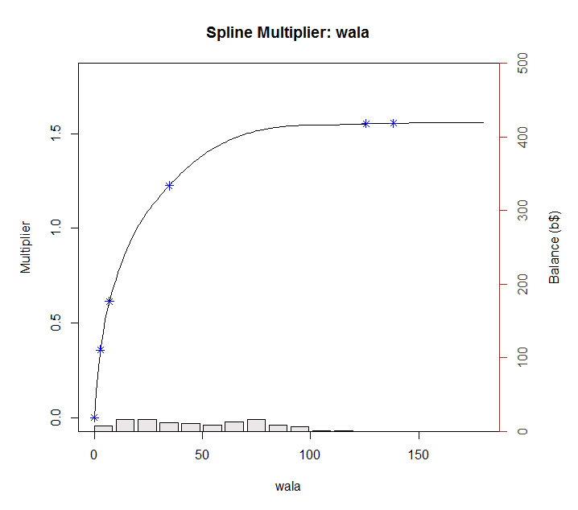
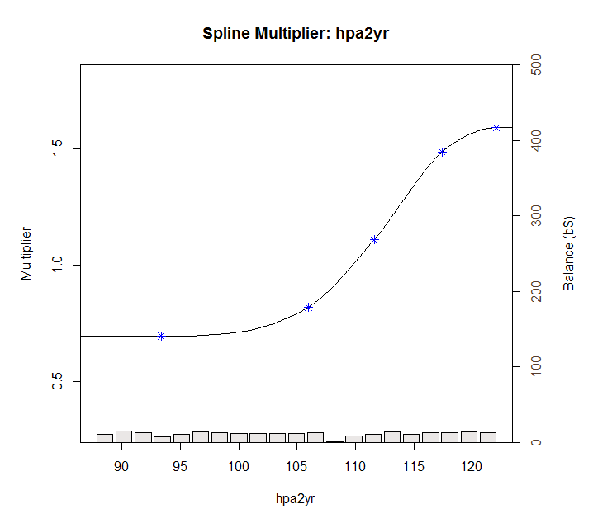
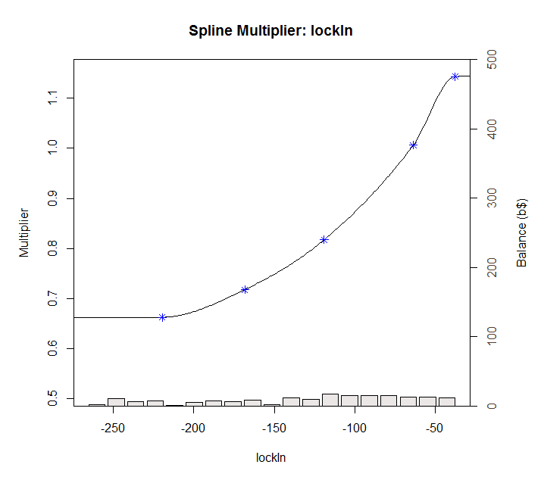
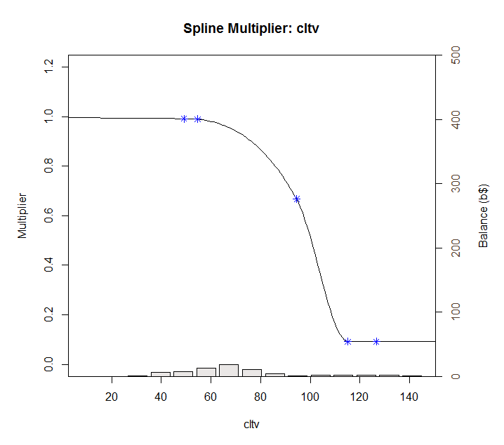
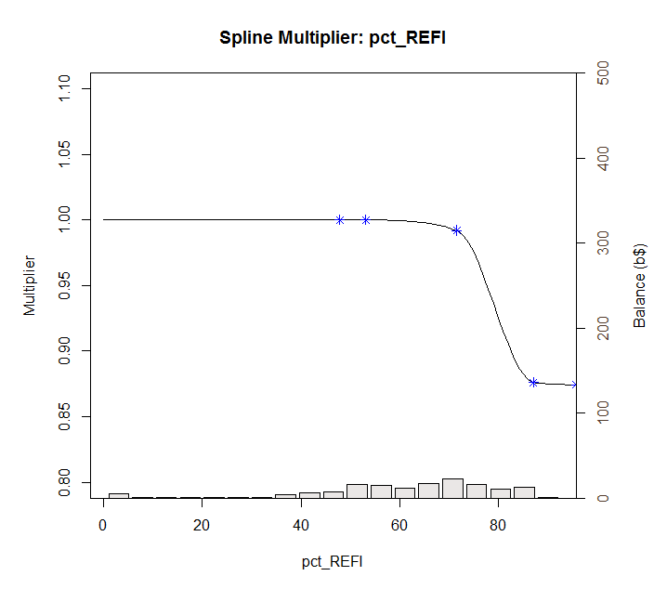
v2 Turnover Model Details 2. Model Multiplier Splines

Slide 21
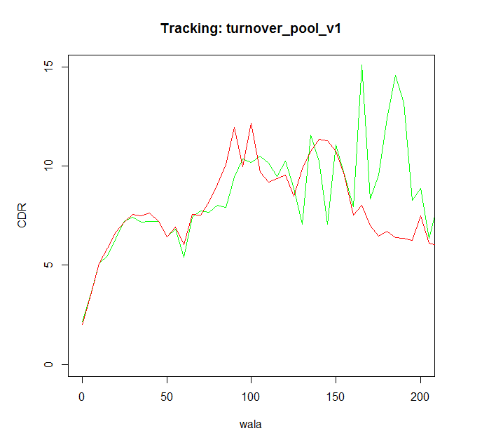
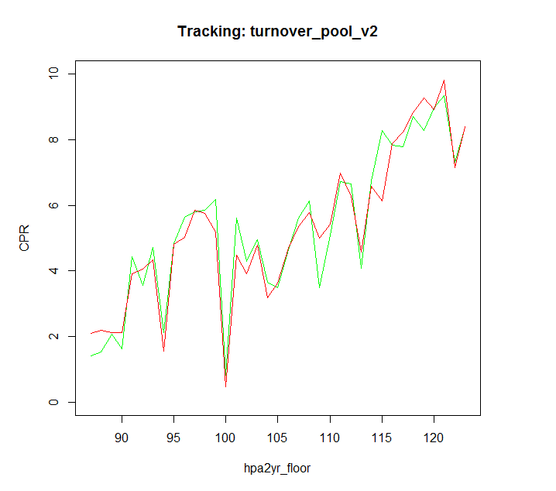
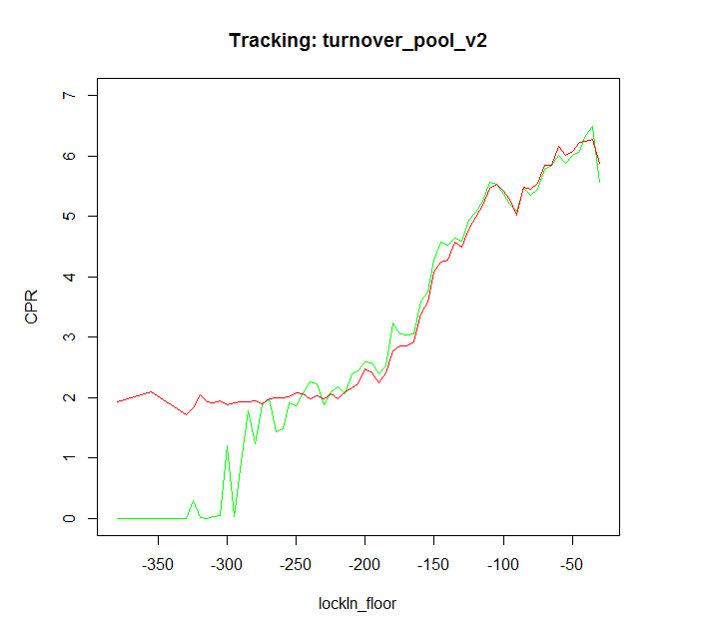
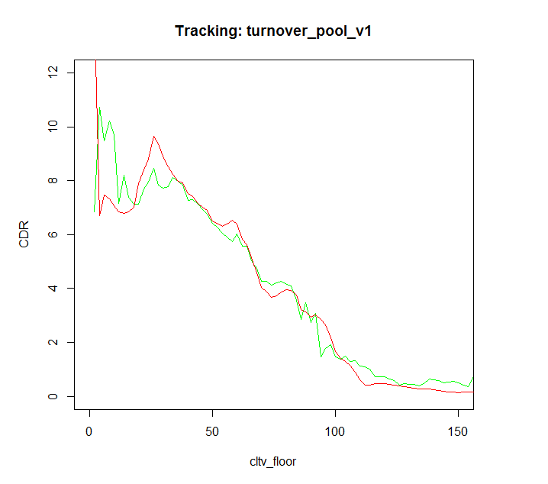
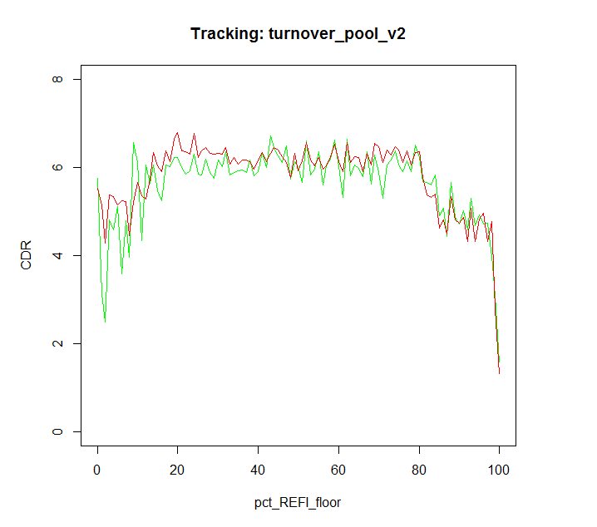
v2 Turnover Model Details 3. Model Multiplier Tracking
Actual
Model

Slide 22
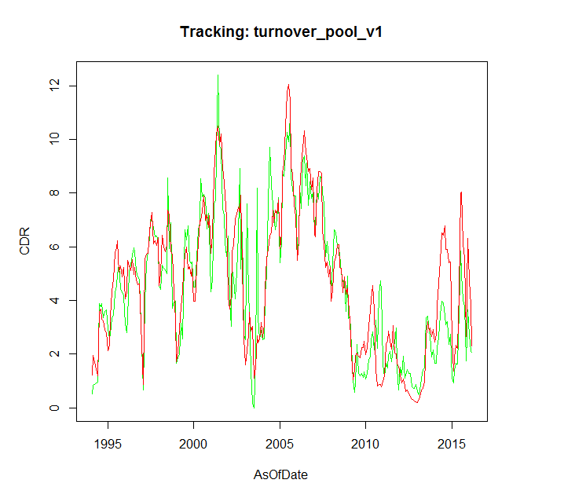
Tracking Performance 1. Overall
Model Tracking Performance – Overall (Conventional + Jumbo + CQ/CR)
Actual
Model

Slide 23
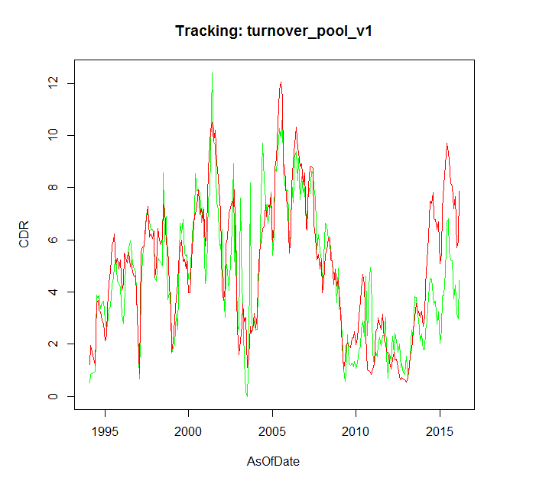
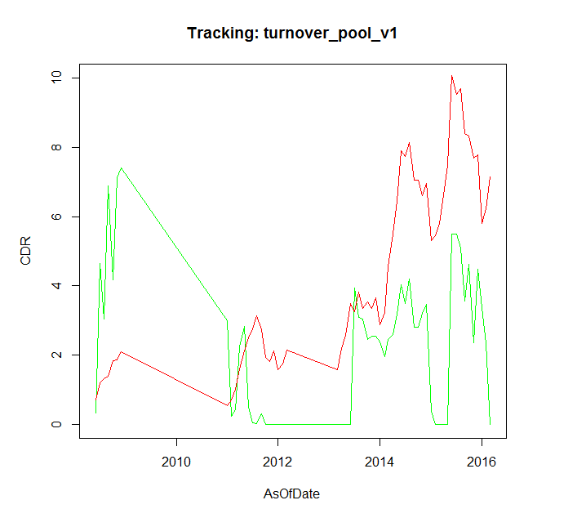
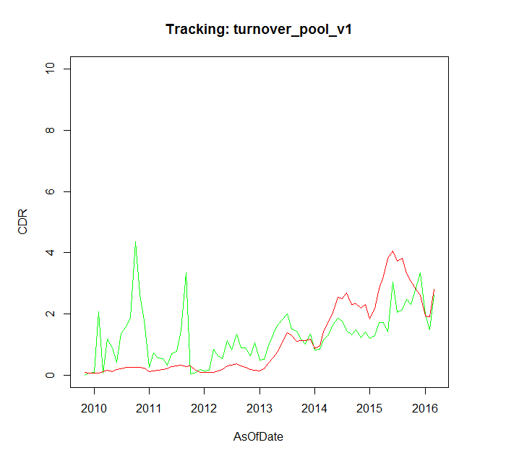
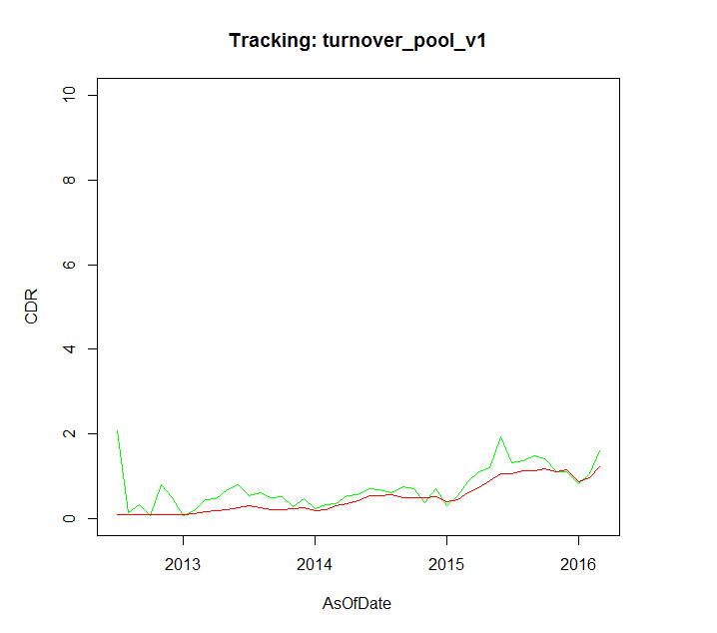
Tracking Performance 2. By Pool Types
Model Tracking Performance
Conventional
Jumbo
Conventional pool tracking shows model is 2% CPR faster in most recent one year.
Few Jumbo pools with OTM incentive.
CQ
CR
CQ pool tracking is more reliable now, as we fixed the incentive calculation for HARPed loans.
Similar to CQs
Actual
Model

Slide 24
v2 Turnover Model Details 3. Performance Comparasion
Model v1 and v2 results are quite similar (both are about 2% CPR too fast for recent time periods). v2 has a lower RMSE (1.218) versus v2 (1.303).
V2 is better
V2 is better
V2 is better
* All results based on data with updated incentive and OTM cash-out

Slide 25
Appendix 1. Max Value of Multipliers
 | Min | Max
baselineConstant | 5.823
wala | 0 | 1.570958
hpa | 0.694794 | 1.530962
lockin | 0.474579 | 1.148333
cltv | 0.079905 | 0.987166
seasonality | 0.683492 | 1.241067
Product of Multipliers | 0 | 3.383621
CPR | 0 | 19.71

Slide 26
Further Research 1. Replace HPA 2yr with MCAI?
The Relationship between MCAI and HPA2Yr
In our current model, we use a two-year HPA moving average as a measure of mortgage credit availability. However, comparing the Mortgage Credit Availability Index and HPA2Yr curves, we can see a dispersion between them after 2013. At the same time, our model tracking error goes up.
We should look at changing the credit availability measure in a future version of model. MCAI would be one possible choice. In that case, since the MCAI is calculated by using origination information on all kinds of loan products(including non-agency products), we need to actively maintain the market share of different products. We will also need to smooth the MCAI so that a blip in production characteristics for a month doesn’t have a profound impact in forward projections.

Slide 27
Further Research 2. Backfilling and Forecasting MCAI
Predicting MCAI from HPA2Yr
As one would expect, there’s a strong relationship between HPA2yr and the MCAI. We can use this relationship to backfill MCAI data prior 2003 and to also forecast MCAI on the forward interest rate paths.

